Slide 1
Consumer and producer surplus
Chapter 4

Slide 2
Buy some new shirts, George!
George wants to buy some new shirts for work. He is willing to pay $35 for the first shirt, $25 for the second shirt, and $15 for the third.
Oxford & Co. (his favorite shirt shop!) sells shirts for $28 each.
What is the efficient number of shirts for George to buy?
0
1
2
3
Notes:
What is his consumer surplus?

Slide 3
Buy some new shirts, George!
George wants to buy some new shirts for work. He is willing to pay $35 for the first shirt, $25 for the second shirt, and $15 for the third.
Oxford & Co. (his favorite shirt shop!) sells shirts for $28 each.
What is George’s consumer surplus?
$0
$7
$10
$28
$35
Notes:
What is his consumer surplus?

Slide 4
Calculating consumer surplus
Mark and Rasheed are buying new calculators for Math 19. Mark is willing to pay $75 and Rasheed is willing to pay $100 for a graphing calculator. The price for a calculator at the bookstore is $65. How much is their total consumer surplus?
$10
$35
$45
$60
Notes:
Answer: $45

Slide 5
If the price of hamburgers is $2, consumer surplus will equal:
$650
$400
$225
$450
Notes:
Answer: $225

Slide 6
If the price of hamburgers is $2.50 today, what will happen to the price in the coming days/months?
It will fall
It will rise
It will remain the same
Not enough information

Slide 7
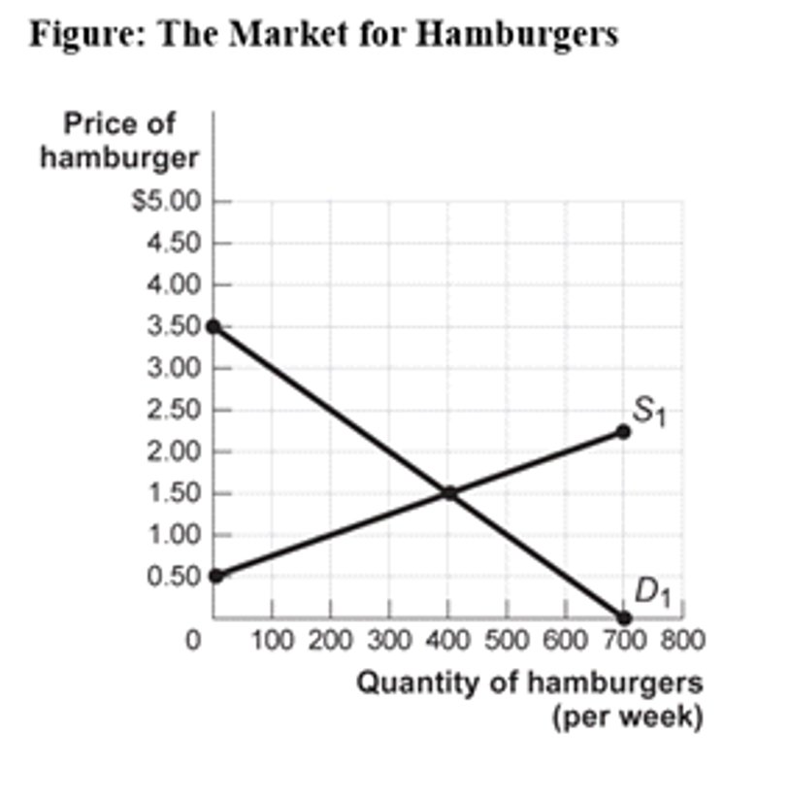
If the price of hamburgers rises, what will be the main effect on the chart?
Supply will shift left
Supply will shift right
Demand will shift left
Demand will shift right

Slide 8
If the price of a hamburger is $2, consumer surplus will be …
$650
$450
$400
$225

Slide 9
What is your consumer surplus?
The sky is dumping freezing rain, it’s 11:30 at night, and you’re standing on a street corner 15 miles from home. You open your Uber app and see that the trip is going to cost you roughly $50, as prices are surging 200 percent above normal. But you summon the car anyways. In fact, you might not have hesitated to go as high as $100, just to get dry in that comprising moment.
Laura Bliss, Bloomberg, 15 September 2016

Slide 10
Four different students each have one textbook they might sell back to the bookstore. Below is each student’s reservation price: the lowest price at which they would be willing to sell the book.
The bookstore is buying textbooks at a price of $25.
Seller | Seller’s Reservation Price
Alex | $12
Piper | $16
Daya | $22
Red | $30
How many students will sell their textbooks?
0
1
2
3
4

Slide 11
If 400 hamburgers are sold, producer surplus will equal
$650
$400
$510
$200
Notes:
Answer: $200

Slide 12
If the price falls from $1.50 to $1, what is the loss in producer surplus?
$50
$45
$150
$200
Notes:
Answer: $150

Slide 13
If the price of hamburgers is $2, consumer surplus will equal:
$650
$400
$225
$450
Notes:
Answer: $225

Slide 14
If the price of hamburgers is $2.50 today, what will happen to the price in the coming days/months?
It will fall
It will rise
It will remain the same
Not enough information

Slide 15
If the price of hamburgers rises, what will be the main effect on the chart?
Supply will shift left
Supply will shift right
Demand will shift left
Demand will shift right

Slide 16
If the price of a hamburger is $2, consumer surplus will be …
$650
$450
$400
$225

Slide 17
If 400 hamburgers are sold, producer surplus will equal
$650
$400
$510
$200
Notes:
Answer: $200

Slide 18
If the price falls from $1.50 to $1, what is the loss in producer surplus?
$50
$45
$150
$200
Notes:
Answer: $150

Slide 19
Look at the market for octopus candle holders. What is producer surplus at equilibrium?
$1000
$2000
$4000
$8000

Slide 20
Look at the market for octopus candle holders. What is total surplus at equilibrium?
$1000
$2000
$4000
$8000
Notes:
2000

Slide 21
Amazon caps the price at $15. What is the new producer surplus?
$1125
$1875
$2000
$2250

Slide 22
Efficiency of Markets
Competitive markets are usually efficient:
Allocate consumption to the potential buyers who most value it.
Allocate sales to potential sellers who most value right to sell the good (e.g., who have the lowest cost).
They ensure that all transactions are mutually beneficial
Notes:
Mutually beneficial Every consumer who makes a purchase values the good more than every seller who makes a sale.

Slide 23
Why markets typically work so well
Well-functioning markets are effective because of:
Property rights: the rights of owners of valuable items, whether resources goods, to use those items as they chooseor.
Economic signals: any piece of information that helps people make better economic decisions.
Notes:
Prices translate complex information into an easy signal for producers:
Profits rise in industries when consumers want more of that industry’s products.
Profits decline in industries when consumers want less of that industry’s products.
The high price of ice in post-Katrina New Orleans made it more attractive for firms to provide ice where society needed it most.

Slide 24
Four sources of market failures
Markets will not be efficient in the presence of market failures!
Lack of competition
Information not shared by all parties
Existence of external benefits/costs (externalities)
Existence of public goods

